Slide 1

The Linux File System and Permissions

Slide 2
Learning Objectives
By the end of this module, you will be able to understand:
The structure of Linux file system
Various types of Linux file system
What is the file system permission in Linux
How to set or change the permission of any file or directory
About some special permission in Linux
Notes:
Concise audio:
In this chapter, we will discuss and learn about Linux file system management. By the end of this chapter, you will be able to understand:
The structure of Linux file system
Various types of Linux file system
What is the file system permission in Linux
How to set or change the permission of any file or directory
About some special permission in Linux
Partitioning in Linux and Creating partition
Disk quota management
LVM (Logical Volume Management) in Linux

Slide 3
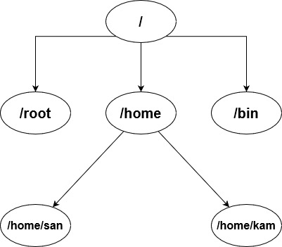
Introduction to File system
What is File System?
  Way that an OS store, retrive and organizes files on disk.
Linux files are stored in a single rooted, hierarchical file system and on the top of hierarchy is / - the root directory.
Notes:
Concise audio
Let’s get into an introduction to the File system.
What is a File system?
A file system is a way that an operating system store, retrieve and organizes files on a disk.
As shown in the figure the Linux files are stored in a single-rooted, hierarchical file system.
Point to remember
/ is a root file system or root directory. Everything will come under the root.
Also here / and /root are two different folder where as / is called root file system and /root is called root folder under root file system.

Slide 4

File System Types
File systems come in many different flavors depending on our specific needs.
Windows
  NTFS, FAT, FAT16, or FAT32
For Macintosh
  HFS
Linux
  Ext2/3/4,XFS
Notes:
Different operating systems support different types of file systems. The choice of file system will depend on the specific needs and requirements of the system in question.
For Windows, you have the NTFS, FAT, FAT16, or FAT32 file systems.
For Macintosh, you have the HFS file system and for Linux you have more file systems: ext2/3/4,XFS etc.

Slide 5


Ext – Extended File System
Extended File System also called as first extended file system (Ext1)
Released in April 1992 and added to Linux 0.96c.
Limitations
  No Journaling
  No symbolic links
  Max file Size is 2 GB
  No extended attributes
Notes:
Concise audio
Lets discuss more on Linux File system types.
First is Ext file system.
The ext (first extended) file system is the first version of the extended file system, which is a family of file systems used by many Linux distributions. The ext file system was released in 1992 and added to Linux 0.96c.
The ext1 file system had some limitations and drawbacks compared to later versions of the extended file system, including:
No journaling: The ext1 file system did not include journaling, which meant that if the system crashed or the file system was not unmounted properly, it could take a long time to check and repair the file system.
No symbolic links: The ext1 file system did not support symbolic links, which are a key feature of Unix-like file systems.
No large file support: The ext1 file system was limited to files no larger than 2 GB.
No extended attributes: The ext1 file system did not support extended attributes, which allow for additional metadata to be stored with files and directories.
Because of these limitations, the ext1 file system is no longer in use and has been superseded by newer file systems.

Slide 6

ext2 - Second Extended Filesystem
• Developed by Remi Card in January 1993
• Replacement for extended file system
• Key Features
  File permissions
  Large file support
  Large volume support
  Maximum Number of files : 10^18
  Directory Indexing
  Online Resizing
Notes:
Concise audio
The ext2 (second extended) file system was developed by Remi Card in 1993 as an improvement over the original ext file system (ext1),
Here are some key features of the ext2 file system:
File permissions: The ext2 file system includes a sophisticated file permission system that allows for different levels of access to files and directories.
Large file support: The ext2 file system supports large files up to 16GB - 2TB, depending upon block size (1K, 2K, 4K or 8K).
Large volume support: The ext2 file system supports volumes up to 2TB to 32 TB terabytes in size, depending upon block size (1K, 2K, 4K or 8K)
Directory indexing: The ext2 file system includes a feature called "dir_index" that speeds up file access by indexing the directories on the file system.
Online resizing: The ext2 file system supports online resizing, which means that the file system can be expanded or reduced in size while it is still mounted and in use.

Slide 7

ext3 - Third Extended Filesystem
• Developed by Stephen Tweedie in November 2001
• Key Features
  Journaled file system
  An Ext2 file system can be converted to Ext3 without any need of backup.
  Larger file and volume size is same as of Ext2
Notes:
Concise audio
The ext3 (third extended) file system is a file system was developed by Stephen Tweedie in 2001 as an improvement over the ext2 file system.
Here are some key features of the ext3 file system:
Journaling: The ext3 file system includes journaling, which provides a way to recover from system crashes and other errors more quickly and easily.
An ext2 filesystem can be converted to ext3 without any need of backup.
Glossary
Overall, the ext3 file system is a reliable and robust file system that is well-suited for use on Linux systems. The main advantage of ext3 over ext2 is its journaling feature, which provides improved data reliability and faster file system recovery in the event of system crashes or other errors.

Slide 8

ext4 - Fourth extended filesystem
• Released in October 2008
• Key Features
  Large file support: 16 TB (4K block size)
  Large volume support: 1 EB(16K block size)
  Online defragmentation
  Delayed allocation
  Encryption
  Maximum number of files: 4 billion
Notes:
Concise audio
The ext4 (fourth extended) file system was released in 2008 as an improvement over the ext3 file system, and is currently the default file system for many Linux distributions.
Here are some key features of the ext4 file system:
Large file support: The ext4 file system supports large files, up to several exabytes in size.
Large volume support: The ext4 file system supports volumes up to 1 exabyte in size.
Online defragmentation: The ext4 file system includes a feature called "online defragmentation" that improves file system performance by reducing file fragmentation while the file system is in use.
Delayed allocation: The ext4 file system includes a feature called "delayed allocation" that improves file system performance by postponing the allocation of disk space until it is actually needed.
Encryption: The ext4 file system includes a feature called "encrypted file system" that allows for file-level encryption of data on the file system.
•On a single partition we can create 4 billion files.
Glossary
Overall, the ext4 file system is a highly advanced and versatile file system that is well-suited for use on modern Linux systems. Its advanced features like online defragmentation, delayed allocation, and encryption make it a popular choice for many applications.

Slide 9

XFS
64-bit journaling file system developed by Silicon Graphics in 1994.
Key Features
  Large file support – 8 EB
  Large volume support – 8 EB
  Scalability
  Online resizing
  Advanced features
Notes:
Concise audio
XFS is a high-performance, 64-bit journaling file system developed by Silicon Graphics for use on Linux and other Unix-like operating systems. It was first released in 1994 and has since become a popular choice for many applications, particularly those that require high-performance file I/O.
Some key features of the XFS file system are:
Large file support: The XFS file system supports large files, up to 8 exabytes in size.
Large volume support: The XFS file system supports volumes up to 8 exabytes in size.
Scalability: The XFS file system is highly scalable, with support for large files, large volumes, and many concurrent I/O operations.
Online resizing: The XFS file system supports online resizing, which means that the file system can be expanded or reduced in size while it is still mounted and in use.
Advanced features: The XFS file system includes many advanced features, such as support for file system snapshots, file-level encryption, and extended attributes.
Point to remember
These file systems (ext,ext2,ext3,ext4,xfs) are only for Linux, not Windows

Slide 10
Formatting a Partition
Use Lsblk or fdisk -l to view partition /disk you need to format
sudo fdisk /dev/sdb
Inside fdisk, follow these prompts:
Press n to create a new partition
Choose p for primary
Accept default partition number (usually 1)
Accept default first and last sectors (or specify size)
Press w to write changes
This creates /dev/sdb1
sudo mkfs.ext4 /dev/sdb1
sudo mkdir /mnt/newdisk
sudo mount /dev/sdb1 /mnt/newdisk
df -h

Slide 11
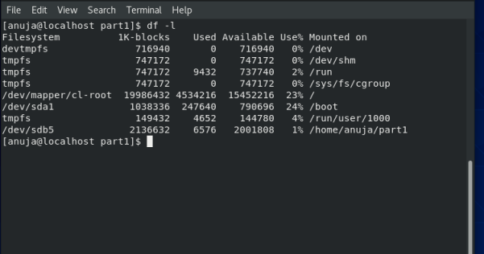
df - report file system disk space usage

Slide 12
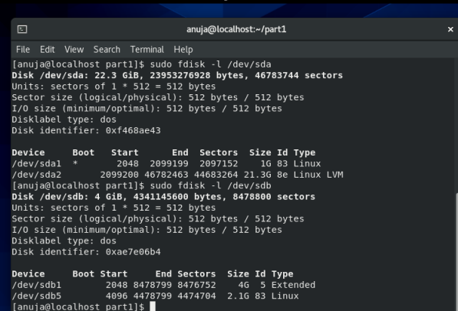
fdisk- to list and manipulate disk partitions

Slide 13

Linux File System Structure
/home
  Default location for user home directories
/bin, /usr/bin
  system commands
/sbin, /usr/sbin
  Commands used by System Administrator
/etc
  All sorts of configuration files
/var
  Contains log files and spools directories etc.
/dev
  device files
/proc
  contains process and kernel information
/tmp
  Holds temporary files created by programs
/opt
  Stores additonal software progarams
/boot
  contains linux kernal and all file used by boot loader
Notes:
Concise audio
Now, let's see the Linux file system structure. It follows the hierarchical structure and the top of the hierarchy we have / and here it calls it a root file system. There are a many directories that comes under this /(root).
/home
Contains the default location for user home directories
/bin, /usr/bin
system commands (like ls, cp, etc) stored in these directories
/sbin, /usr/sbin
These two directories contains the commands used by system admins
/etc
all sorts of configuration files are stored in this folder
/var
Contains log files and spools directories.
/dev
device files are stored in this folder
/proc
contains process and kernel information
/tmp
Holds temporary files created by programs
/opt
Stores additonal software progarams
/boot
contains linux kernal and all file used by boot loader

Slide 14
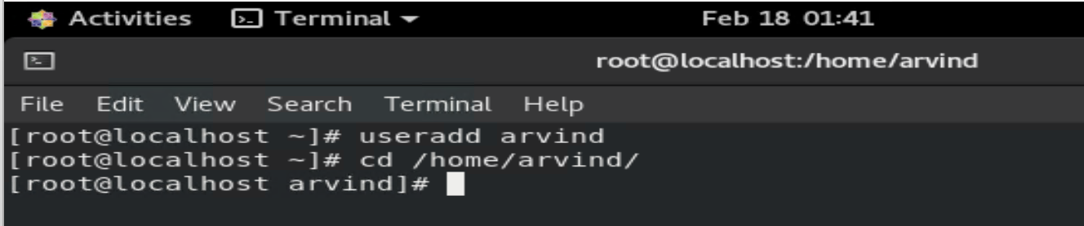
“/home” Directory
/home is the default location for the user’s home directory.
User information will store under the home directory .
user's personal files, configuration files, and user-specific settings are stored.
Notes:
Concise audio
Let’s discuss each directory in detail
The first is /home directory
In Linux, the "/home" directory is the default parent directory for user home directories. Each user on the system typically has a unique home directory located within the "/home" directory.
This directory is where the user's personal files, configuration files, and user-specific settings are stored.
For example:
creating a user here, whose name is Arvind. And data of Arvind will store under home and his name.
Point to remember
useradd command is used to add a new user

Slide 15
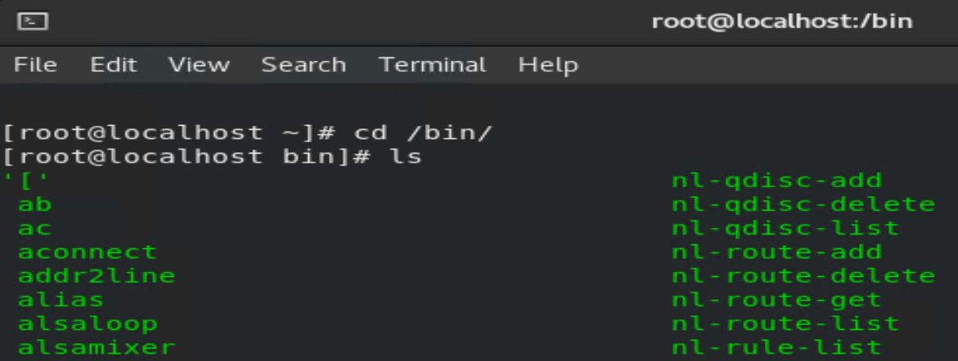
/bin, /usr/bin - Directories
"/bin" directory (short for "binary") typically contains binary executable files that are essential for the basic functioning of the system.
Notes:
Concise audio
Now moving on to the next folder /bin.
/bin
/bin is used to store the system commands(ls,cd,tar,gzip, etc..). Also, copies of these commands will store under /usr/bin. If the user is in single-user mode command will be taken from /bin. And the user in the multi-user mode command will be taken from /usr/bin mode.
Point to remember
Single-user mode(rescue mode): only the root user can able to use the system.

Slide 16
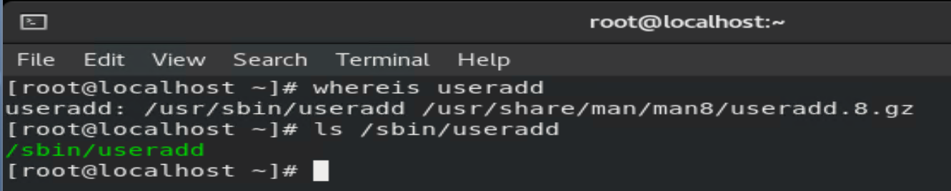
/sbin, /user/sbin - Directories
These two directories contains the commands which are used by the system administrator for perfuming system admin activities.
Notes:
Concise audio
Moving on to the next folder /sbin,/usr/sbin
/sbin, /usr/sbin
It contains essential system programs and utilities that are typically used by the system administrator, rather than by regular users.
For example, useradd is a command to add a user on Linux and this commands is stored under /sbin and /usr/sbin directories.

Slide 17
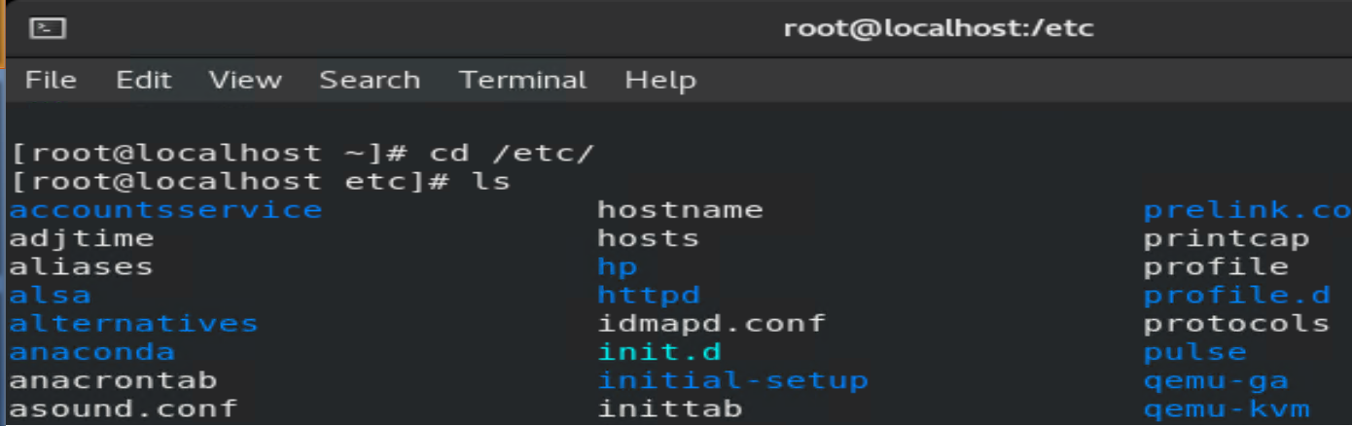
/etc - Directory
Used to store the configuration files.
Notes:
Concise audio
Next folder is /etc
/etc
This directory contains system configuration files and directories that are used to configure various aspects of the operating system, services, and applications. These configuration files are usually stored in plaintext format and can be edited using a text editor or specialized tools.
Point to remember
In Windows Operating system, the configuration will be stored under the system32 folder.

Slide 18
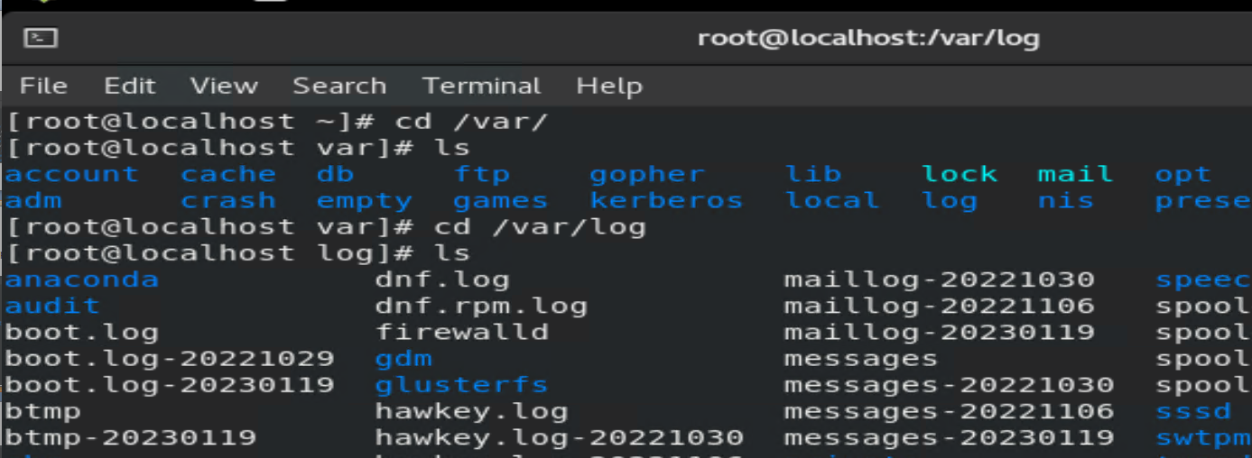
/var - Directory
Contains variable files, including log files, spool files, and temporary files
Notes:
Concise audio
The name "var" is short for "variable," which refers to the fact that the files stored in this directory can change in size and content over time. It is used to store the log files of the system. Any log file generated by the system will be stored in /var.
Apart from the log, it contains the spool directory.

Slide 19
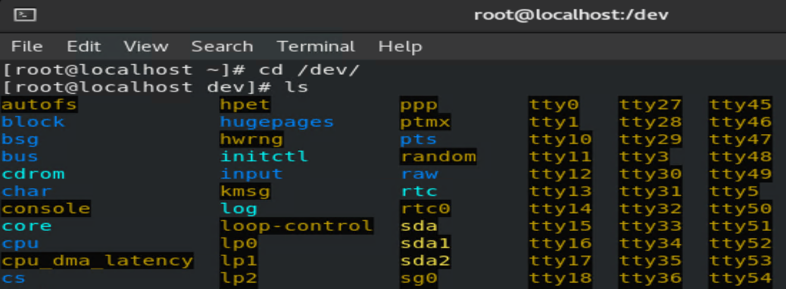
/dev - Directory
Special directory that contains device files.
In Linux, everything is treated as a file.
Notes:
Concise audio
In a Linux, the "/dev" directory is a special directory that contains device files.
Device files are special files that represent devices such as hard drives, USB drives, keyboards, mice, printers, and other hardware devices.
All sorts of device files will be stored under /dev. In Linux, everything is treated as a file.
For example, by connecting a pen drive to the system, one file will be created for the pen drive. And this file will be stored under "/dev."

Slide 20
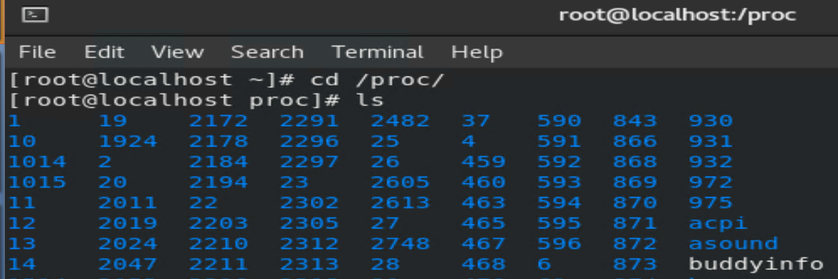
/proc - Directory
Contains information about running processes and system resources.
"/proc" directory are generated dynamically by the kernel and represent information about the current state of the system.
Notes:
Concise audio
In Linux, the "/proc" directory is a virtual file system that contains information about running processes and system resources. Unlike other directories that store files on disk, the files in the "/proc" directory are generated dynamically by the kernel and represent information about the current state of the system.
The types of information available in the "/proc" directory include:
Process information - contain information such as the command-line arguments used to start the process, the current working directory of the process, and the amount of memory used by the process.
System information - the amount of memory and CPU usage, the number of active network connections, and the system uptime.
Hardware information - the CPU type, system architecture, and information about storage devices.

Slide 21
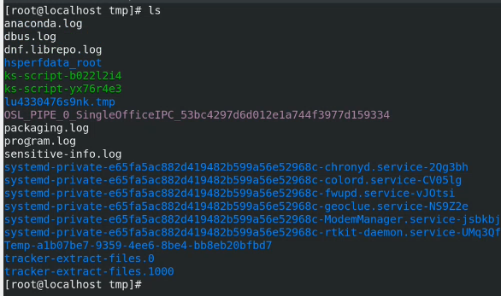
/tmp - Directory
It is a folder that will contain and hold the temporary file, which is actually created by the programmes on the system.
Notes:
Concise audio
Next folder is /tmp
Which is used for temporary files. The name "tmp" stands for "temporary", and this directory is designed to hold files that are needed for a short period of time and can be safely deleted without causing harm to the system or its users.

Slide 22

/opt - Directory
It is used to store additional software programs, that are not part of the core operating system.
These programs are installed under /opt.
Notes:
Concise audio
Next folder is /opt
Which is used for installing additional software packages that are not part of the core operating system.
Points to remember
In Windows, the software is installed under the program file folder.

Slide 23
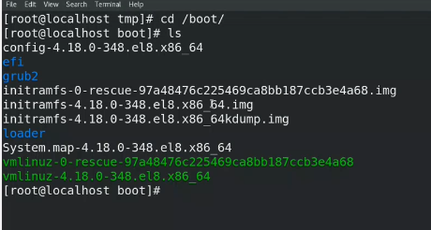
/boot - Directory
/boot is a folder that contains information about the boot loader and the kernel.
Notes:
Concise audio
Next folder is /boot
It contains the files that are necessary for the system to boot, including the kernel, initial ramdisk, bootloader configuration, and other boot-related files.
Point to remember
Grub is the Linux boot loader.

Slide 24

File and Directory Permissions
Linux is a multiuser system, the files of all users are stored in a single file structure.
Mechanism is required to restrict one user to access the files of another user, if he is not supposed to.
User can impose access permission to each file to restrict its access
The term “access permission” refers to
  read permission ( r )
  write permission ( w )
  execute permission ( x )
Notes:
Concise audio
Linux is a multi-user system. More than one user can access the system simultaneously. User files are stored under /home. Therefor under /home folder we have multiple users folders.
If permission is not there, one user can access, delete, and modify another user's file. As a result, some mechanism is required to prevent one user from accessing the file of another user. This mechanism in Linux is called file permission.
So the user can set or restrict permission to their file or directories.
There is three type permission in Linux
permission to read (r)
permission to write (w)
permission to execute (x)
Glossary
Not applicable
Points to remember

Slide 25
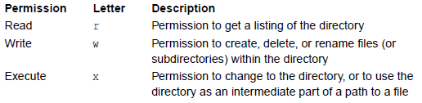
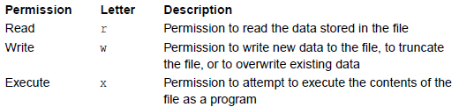
Permissions on Files and Directories
Three types of permissions on files, each denoted by a letter.
A permission represents an action that can be done on the file:
Notes:
Concise audio
In Linux, permissions can be given to both files and directories.
Permission on File
If the Read (r) permission is there on a file, it means permission to read the data that is stored inside the file. That is, if read permission is been given then the user can read the content of the file. The cat command will be used to read the content. If read permission is not there, then the cat command won’t be executed.
If Write(w) permission is there on a file, it means that permission to write new data to the file or truncate the file or overwrite the existing data.
If execute(x) permission is there on a file, it means that permission to attempt to execute the content of the file as a program. That is, if the file is a program file or executable file, then the user can execute that file if x permission is given.
Permission on Directory
If Read (r) permission is there on a Directory, it means that permission to get the list of directories. That is, we can list the content of the directory.
If "write" permission is granted to a directory, it means that permission to create, delete, and rename files within the directory is granted.
Execute(x) permission is there on a directory, it means that permission to change the directory or to use the directory as an intermediate part of a path to a file

Slide 26
Permissions for Different Groups of People
As well as having different types of permission, we can apply different sets of permissions to different sets of people.
A file or directory has an owner and a group owner
The r, w, x permissions are specified separately for the owner, for the group owner, and for everyone else (the ‘world’).
Notes:
Concise audio
There are different types of permission, and we can apply different sets of permissions to different sets of people.
There are three sets of people.
1. Owner- Whoever created the file or directory will become the owner of that file or directory.
2. Group owner - A group can contain multiple users. All the users belonging to a group have the same access permissions for a file.
3.Others - Other than the user or group, anyone who has access to the file falls into the category of "other."Other has neither created the file nor is a group member.

Slide 27
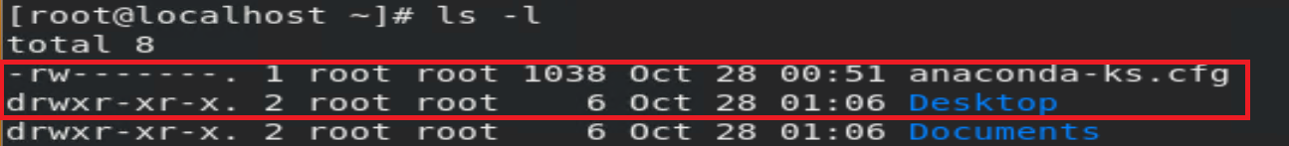
Examining Permissions: ls -l
The ls -l command allows you to view at the permissions on a file:
The first column is the permissions:
  One character for the file type: d for directories, - for plain files
  Three characters of rwx permissions for the owner (or a dash if the permission isn’t available)
  Three characters of rwx permissions for the group owner
  Three characters of rwx permissions for everyone else
The third and fourth columns are the owner and group-owner
Notes:
Concise audio
Linux, like other Unix-like operating systems, allows multiple users to work on the same server simultaneously without disrupting each other.
To start with file permissions, you have to find the current Linux permission settings.
Using the command line, easily find a file’s permission settings with the ls command, used to list information about files and directories. You can also add the –l option to the command to see the information in the long list format.
The ls -l command allows you to view at the permissions on a file:
The first column is the permissions:
One character for the file type: d for directories, - for plain files
Three characters of rwx permissions for the owner (or a dash if the permission isn’t available)
Three characters of rwx permissions for the group owner
Three characters of rwx permissions for everyone else
The third and fourth columns are the owner and group-owner

Slide 28
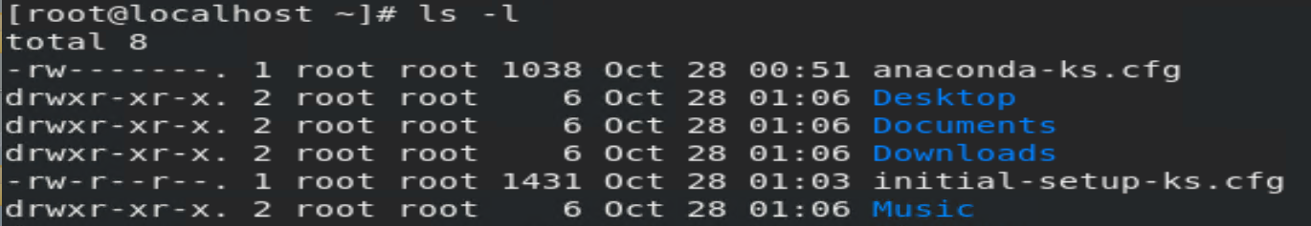
Examining Permissions: ls -l
output provides the following information:
file permission
the owner (creator) of the file
the group to which that owner belongs to
the date of creation.
Notes:
Concise audio
As seen in the image above, the output provides the following information:
file permission
the owner (creator) of the file
the group to which that owner belongs to
the date of creation.
It shows the permission settings, grouped in a string of characters (-, r, w, x), classified into four sections:
1.File type. There are three possibilities for the type. It can either be a regular file (–), a directory (d), or a link (i).
2. File permissions of the user (owner)
Three characters of rwx permissions for the owner (or a dash if the permission isn’t available)
3.File permission of the owner’s group
Three characters of rwx permissions for the group owner
4. File permissions of other users
Three characters of rwx permissions for everyone else
The characters r, w, and x stand for read, write, and execute.
The categories can have all three privileges, just specific ones, or none at all (represented by –, for denied).
Users that have reading permission can see the content of a file (or files in a directory). However, they cannot modify it (nor add or remove files from a directory). On the other hand, those who have writing privileges can edit (add and remove) files. Finally, being able to execute means the user can run the file. This option is mainly used for running scripts.

Slide 29
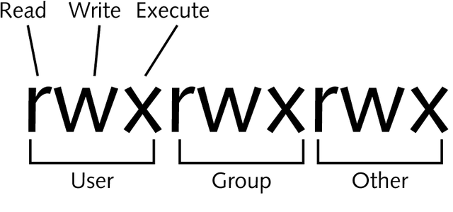
How Permissions are Applied
If you own a file, the per-owner permissions apply to you
Otherwise, if you are in the group that group-owns the file, the per-group permissions apply to you
If neither of those is the case, the for-everyone-else permissions apply to you
Notes:
Concise audio
As all Linux users, you will at some point need to modify the permission settings of a file/directory.
If you own a file, the per-owner permissions apply to you
Otherwise, if you are in the group that group-owns the file, the per-group permissions apply to you
If neither of those is the case, the for-everyone-else permissions apply to you

Slide 30
Changing Permissions
The chmod command changes the permissions of a file or directory
  A file’s permissions may be changed only by its owner or by the superuser
chmod takes an argument describing the new permissions
Simple example: you want to set permission on file abc.txt where owner of the file have rwx(4+2+1) permissions and group has only read permission(4+0+0) and other has none permission(0+0+0).
  #chmod 740 abc.txt
Permissions | Read (r) | Write (w) | Execute (x)
Values | 4 | 2 | 1
Notes:
Concise audio
As all Linux users, you will at some point need to modify the permission settings of a file or directory. The command that executes such tasks is the chmod command. A file’s permissions may be changed only by its owner or by the superuser.
The chmod command, which stands for "change mode," Using the command, we can set permissions (read, write, and execute) on a file or directory for the owner, group, and world.
Syntax:
chmod permissions filename
There are 2 ways to use the command
Absolute mode
Symbolic mode
Absolute mode:
In this mode, file permissions are not represented as characters but a three-digit octal number.
r – 4
w – 2
x – 1
Simple example: you want to set permission on file abc.txt where owner of the file have rwx permissions and group has only read permission and other has none permission.
$ chmod 740 abc.txt
This is how you can change user permissions in Linux on file by assigning an absolute number.

Slide 31
Changing Permissions
In symbolic mode, you can modify the permissions of a specific owner
Permissions can be set using letters in the following format:
  [ugoa][+=-][rwx]
The first letters indicate who to set permissions for:
  u for the file’s owner, g for the group owner, o for other users, or a for all users
= sets permissions for files, + adds permissions to those already set, and – removes permissions
The final letters indicate which of the r, w, x permissions to set
Notes:
Concise audio
In the Absolute mode, you change permissions for all 3 owners. In symbolic mode, you can modify the permissions of a specific owner. It makes use of mathematical symbols to modify Unix file permissions.
Permissions can be set using letters in the following format:
[ugoa][+=-][rwx]
To specify permission settings using alphanumerical characters, you’ll need to define accessibility for the user/owner (u), group (g), and others (o), all(a)
+ means Adding a permission to a file or directory
– means Removes the permission
= means sets the permission and overrides the permissions set earlier.
Type the initial letter for each class, followed by the equal, add, remove (=+-), and the first letter of the read (r), write (w), and/or execute (x) privileges.
For example:
chmod o=rwx filename, in this example giving all read-write execute permission to the other user.
In this example, chmod g+x filename adds execute permission to the group user.

Slide 32
Default Permissions
The default permission for a file or directory is determined by the umask value of the user's shell.
The umask command allows you to affect the default permissions on files and directories you create.
For directories, the defaults permission bits are (rwxrwxrwx) 777 and for files they are 666 (rw-rw-rw).
Value | Description
0 | read, write and execute (Only Directories)
1 | read and write
2 | read and execute
3 | read only
4 | write and execute
5 | write only
6 | execute only
7 | no permissions
Notes:
Concise audio
In Linux, the default permission for a file or directory is determined by the umask value of the user's shell. The umask is a 3-digit octal number that represents the permissions that are not allowed for new files and directories created by a user.
When a new file or directory is created, the permissions are calculated based on the default permission bits (read, write, and execute) of the file or directory and the umask value. The default permission bits for files are typically 666, which means the owner, group, and other users can read and write the file. The default permission bits for directories are typically 777, which means the owner, group, and other users can read, write, and execute the directory.
The umask value is then subtracted from the default permission bits to determine the actual permission bits for the new file or directory. For example, if the umask value is 022, the permission bits for a new file would be 644 (666 - 022), which means the owner can read and write the file, while the group and other users can only read the file. The permission bits for a new directory would be 755 (777 - 022), which means the owner can read, write, and execute the directory, while the group and other users can only read and execute the directory.
The umask command allows you to affect the default permissions on files and directories you create.
The following table is used to calculate the value of umask for setting up default permissions for new files or directories.
For example to set the default permission of directory as :
Owner – rwx
Group Owner – r
Others – no permissions
The following umask command will set the resulting default permission for directory
#umask 047

Slide 33
Special Permissions
Three special permissions
  Setuid (SUID)
  Setgid (SGID)
  Sticky bit
The special owner, known as the root, also has special permissions to run anything and everything.
Notes:
Permissions are a crucial part of Linux. The chmod command is typically used to set and modify simple permissions.
However, in Linux, there are three special permissions that can be set on files and directories in addition to the standard read, write, and execute permissions.
These special permissions are known as SUID, SGID, and the "sticky bit." When applied to a particular executable, special permissions run with the permissions of the owner of the file or the group.
In other words, it elevates the user’s privileges to those of the owner, typically root, temporarily when using that executable. However, incorrect usage of special permissions can become a serious threat. In fact, in the field of cyber security, it is used as a potential vulnerability to escalate privileges on a machine. So use it wisely and very, very carefully.
Lets discuss each special permission one by one

Slide 34
SUID - Special Permissions
SUID, or Set Owner User ID, is a permission bit flag that applies to executables.
If set on a file, user who executes the file becomes owner of the file during execution and it execute with privileges of owner.
Expressed with an “s” instead of “x” in ‘user’ position in a listing:
Setting SUID
Notes:
Concise audio
SUID, or Set Owner User ID, is a permission bit flag that applies to executables. SUID allows an alternate user to run an executable with the same permissions as the owner of the file instead of the permissions of the alternate user.
For example, let’s take the passwd command. The passwd command is used to change a user’s password. Now, if we look at the file in detail, we’ll notice that instead of an x which stands for executing, there will be an "s". The "s" here stands for SUID. You will further note that the file belongs to root user. This technically means that only root user has permission to execute it; however, you will note that everyone can execute the command. As such, with the SUID permissions set.
Now user who executes “passwd” command will be able to change his password because SUID permission is set, therefore when user execute this command, then the command gets executed with the privilege of the root.
SUID is not something to be taken lightly, and as such, one must be very careful when assigning it. In fact, there are special attacks in cyber security that aim precisely at executables running on SUID.
To set the SUID permission on a file, you can use the command:
chmod u+s executable
Now here, there are times when you might see a capital "S". The capital "S" means that the file isn’t executable yet.
To revoke the SUID rights, type:
chmod u-s script

Slide 35
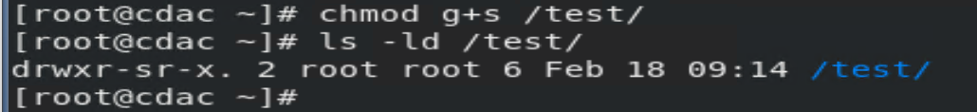
SGID - Special Permissions
Can be set both on Files and Directories.
If a directory is setgid (‘set group-id’), files created within it acquire the group ownership of the directory.
  And directories created within it acquire both the group ownership and setgid permission
Expressed with an s in ‘group’ position in a listing and can be set with following command:
Setgid permission may also be applied to executable files
  A process run from a setgid file acquires the group id of the file and it execute with privileges of group.
Notes:
Concise audio
SGID is similar to SUID. In the SUID, the executable in question runs with the privileges of the owner of the file. In the SGID, if it’s an executable, then it runs with the permissions of the group. If it’s a directory, it results in all new files and directories created to belong to the group.
To set the SGID using the numeric method:
chmod g+s executable
example: chmod g+s script

Slide 36
Sticky Bit - Special Permissions
Sticky bits apply to directories.
It Ensures that a user can only delete files his/her own files
Only a file’s owner may delete it from a sticky directory
Useful for shared directories, such as /tmp
Expressed with a t (mnemonic: temporary directory) in a listing:
Enable ‘sticky’ permission with:
  # chmod o+t /tmp/newuser
Notes:
Concise audio
Sticky Bits
Sticky bits apply to directories. When sticky bits are set on a particular directory, any user who has access to the directory and its contents can only delete their own files and cannot delete files belonging to someone else. Sticky bits are typically used when using a shared folder.
No one person can delete another’s file within the shared folder even if the permission is 777
This is useful for shared directories, such as /tmp, where users need to be able to create and edit their own files, but should not be able to modify files owned by other users.
Following command can be used to set sticky bit on any dirrectory
example: chmod o+t /tmp/newuser

Slide 37
Summary
In this chapter , you have learned that:
Manage file permission to different user
The owner of a file can change the permissions for user (u), group (g), or others (o) by adding (+) or subtracting (-) the read, write, and execute permissions.
The permissions can be changed using chmod command
Know how to change the permission of any file
As all Linux users, you will at some point need to modify the permission settings of a file or directory. The command that executes such tasks is the chmod command. A file’s permissions may be changed only by its owner or by the superuser.
The chmod command, which stands for "change mode," Using the command, we can set permissions (read, write, and execute) on a file or directory for the owner, group, and world.
Understand Structure of Linux file system
A file system is a way that an operating system store, retrieve, and organizes file on a disk. Linux files are stored in a single-rooted, hierarchical file system
Understand Special Permission
Permissions are a crucial part of Linux.
There are three special permissions in Linux : SUID, SGID and Sticky Bit.
Notes:
Concise audio
In this session, you have learned that:
Manage file permission to different users
The owner of a file can change the permissions for user (u), group (g), or others (o) by adding (+) or subtracting (-) the read, write, and execute permissions.
The permissions can be changed using chmod command
Understand Structure of Linux file system
A file system is a way that an operating system stores, retrieves, and organizes files on a disk. Linux files are stored in a single-rooted, hierarchical file system.
There are three broad categories of files in Linux.
General Files: These are ordinary files made up of binary or ASCII data. These are regular files such as documents, images, audio and video files, etc.
Directory Files: In Linux, directories are also categorized as files since they also serve as storage space for other files and folders.
Device Files: These are special files that provide an interface to device drivers, which enable the usability of hardware devices on the system such as mice, keyboards, USB devices, hard drives, etc. These are found in the /dev directory.
Know how to change the permission of any file
As all Linux users, you will at some point need to modify the permission settings of a file or directory. The command that executes such tasks is the chmod command. A file’s permissions may be changed only by its owner or by the superuser.
The chmod command, which stands for "change mode," Using the command, we can set permissions (read, write, and execute) on a file or directory for the owner, group, and world.
Do some special permission
Special permissions make up a fourth access level in addition to user, group, and others. Special permissions allow for additional privileges over the standard permission sets (as the name suggests). There is a special permission option for each access level discussed previously.
In the next chapter, let us learn more about

Slide 38
End of the Chapter Assessment

Slide 39
Q1. Which of the following commands can be used to change default permissions for files and directories at the time of creation
  chmod
  chown
  umask
  suid
  Q2. The default umask for a non-privileged user on a Red Hat system is:
A. 777
B. 222
C. 022
D. 755
Notes:
Audio:
It is time for a quick knowledge check.
Read the question carefully and answer.
Select the correct option and then click or tap Submit.
Key for Q1: C
Complexity Q1: (Easy/Medium/Hard): Easy
Key for Q2: C
Complexity Q1: (Easy/Medium/Hard): Medium

Slide 40
Q3. _______________ If set on a file, user who executes the file becomes owner of the file during execution and it execute with privileges of owner.
A. SUID bit
B. SGID bit
C. Sticky bit
D. umask bit
Q4. Which directory in Linux stores all the process information like file descriptors, virtual memory mapping etc.?
A. /where
B. /etc
C. /Proc
D. /root
Notes:
Audio:
Key for Q3: A
Complexity Q1: (Easy/Medium/Hard): Medium
Key for Q4: C
Complexity Q1: (Easy/Medium/Hard):EASY

Slide 41
Q5. How would you turn on the sticky bit on the directory /tmp?
A. chmod u+s /tmp
B. chmod +st /tmp
C. chmod a+s /tmp
D. chmod o+t /tmp
Q6. What is the PID of SystemD Process?
A. 0
B. 1
C. 2
D. none of the these
Notes:
Audio:
Key for Q5: D
Complexity Q5: (Easy/Medium/Hard):EASY
Key for Q6: B
Complexity Q6: (Easy/Medium/Hard):EASY
Key- Q5: True
Key-Q6: A

